Slide 1


Analysis of UP politicians twitter activity during UP elections

Slide 2
Team No - 5
Purnima Grover - 2021201014
Krupa Kiranmai - 2021201022
Diksha Daryani - 2021201045
Aman Izardar - 2021201028
Debashish Roy - 2021201034
Shikha Raghuwanshi - 2021201055

Slide 3
PROBLEM STATEMENT
In today's high tech world, political parties take help of social media platform like twitter to increase number of votes which they will get in elections.
We are analysing the activities of political leaders of different parties and how these activities are affecting results of elections and perspective of people.

Slide 4
OBJECTIVES
Election results revolve around top leaders of different political parties.
Analysis of attention gained by the party through twitter activity of politicians from different parties.

Slide 5
Data collection
Selected 10 politicians from different parties having highest number of followers on twitter
Collected their tweets from 1st Jan 2022 to 10th March 2022
Post election data was collected from 11th March to 6th April.
List of politicians
AditiSinghRBL
smritiirani
shaziailmi
BJPVinodSonkar
asim_arun
ptshrikant
myogiadityanath
AnilRajbharbjp
brajeshpathakup
kpmaurya1
Babyranimaurya
Santoshpandemla
DrDharamSaini
yadavakhilesh
profamishra
SwamiPMaurya
yadavteju
AbdullahAzamMLA
shivpalsinghyad
VinayHSTiwari
VTankhaRewa

Slide 6
Election results revolve around Top leaders of different political parties.

Slide 7
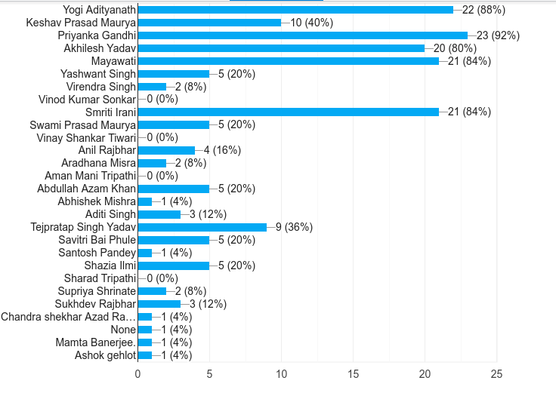
Familiarity With UP Political Leaders, Survey response

Slide 8
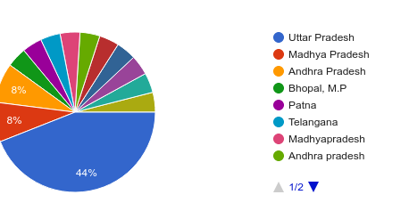
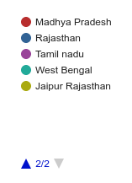
Demographic of users responded in survey

Slide 9
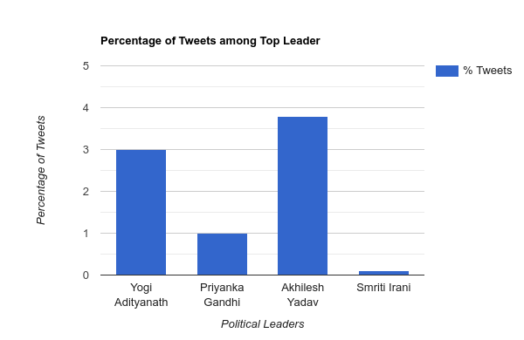
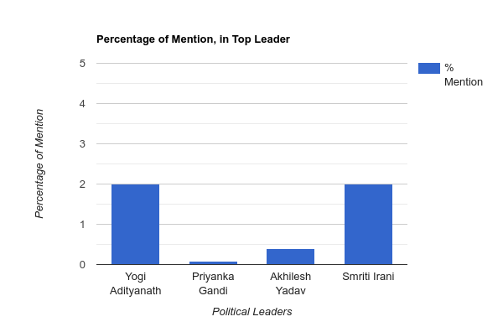
Mention percentage and number of tweets by top leaders

Slide 10
Politicians from different parties trying to bring more attention to party and make people more engaged in the twitter

Slide 11
Selects UP politicians from different parties.
From the selected tweets we try to analyse the following:
How many retweets, likes those tweets are getting.
Under what keywords they are mentioning their party people and other party people.
Who are the other party people and their party people retweeting their tweets.
Frequency of tweets they are posting related to elections.

Slide 12
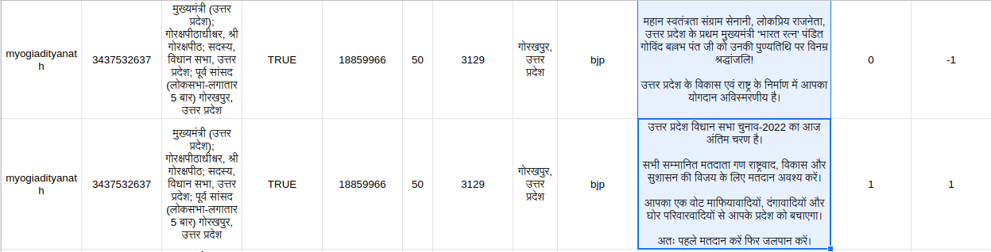

Slide 13
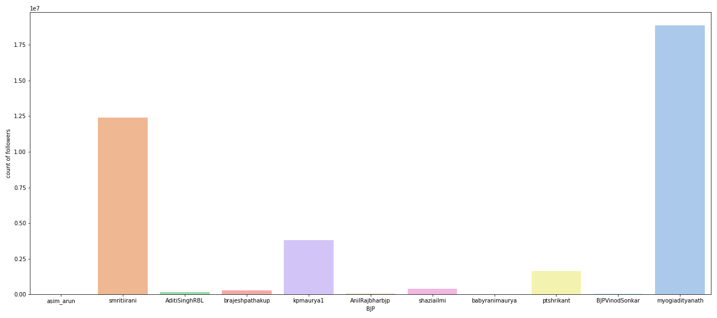
Count of Followers of BJP leaders

Slide 14
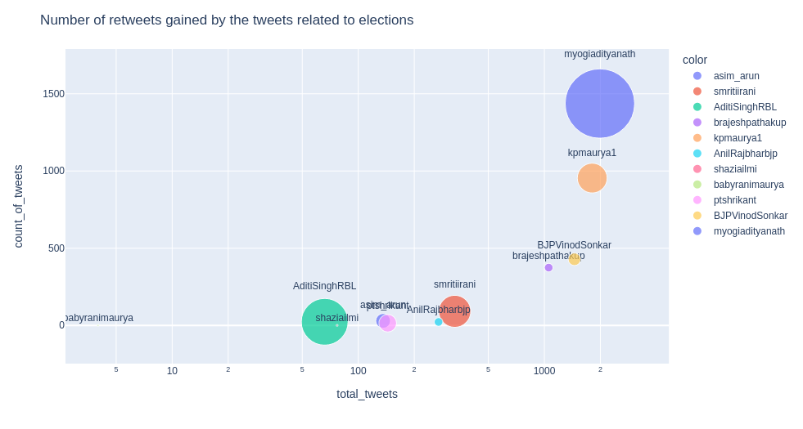

Slide 15
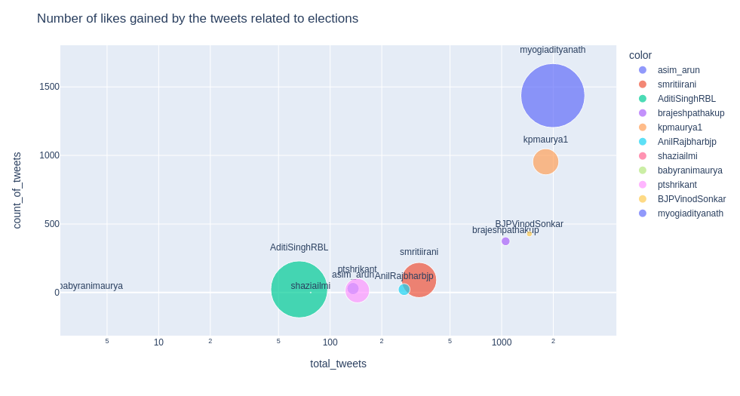

Slide 16
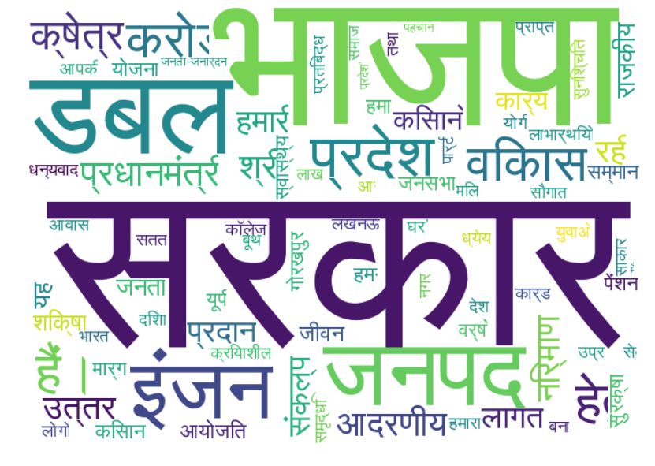
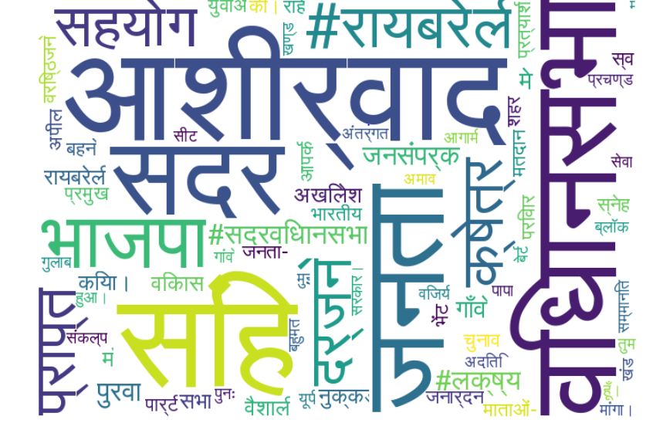
Myogiadityanath
AditiSinghRBL

Slide 17
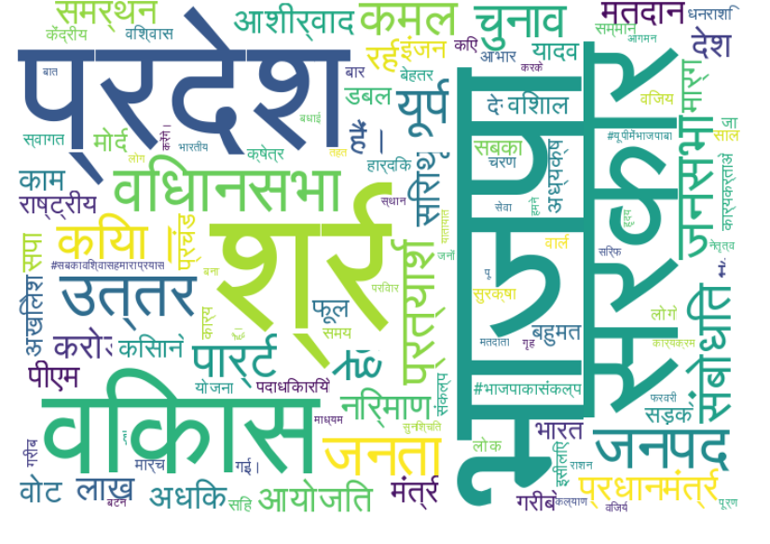
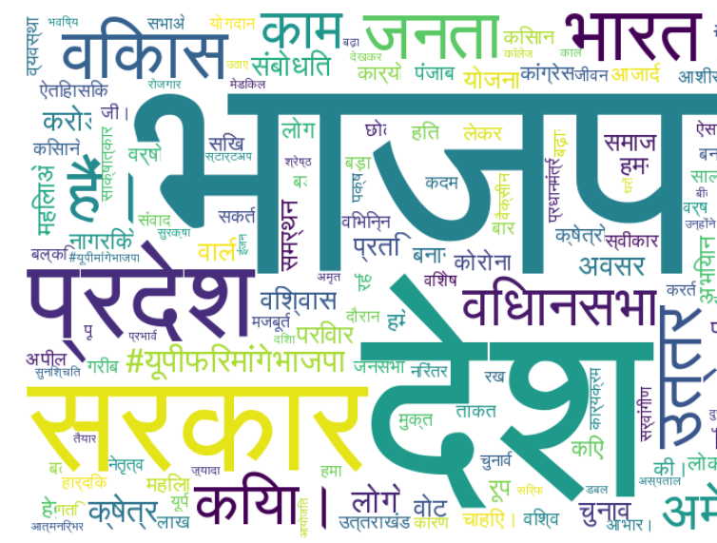
kpmaurya1
Smritiirani

